Slide 1
ABMM06: Surveys
kristofer.soderstrom@kultur.lu.se
Kristofer söderström, Information studies

Slide 2
About me
PhD Information Studies (2023)
Focus on quantitative methods with theoretical framing
Statistical, social network, geospatial and text analysis.
Researcher (2024-)
Search engines, generative AI
Social and technical perspectives, digital methods
Text scraping, topic modelling.
https://portal.research.lu.se/sv/publications/the-dynamics-of-beamline-configurations-and-user-communities-quan
Notes:
Defended last friday

Slide 3
Outline
Brief refresher quantitative methods
Sampling
Types of data
Digital Methods
Basics
An example
Surveys
Basics
Types of questions
Presenting results
Evaluating your survey

Slide 4
Quantitative Methods - Overview
From quantitas, measurable
Can say something about how widespread a phenomenon is
Whether the phenomenon is spread differently within different population groups
Robust, easy to validate
However,
More ”on the surface”. Not as deep as qualitative methods
Hard to get insight into thoughts, motivations, drive. “Why?”

Slide 5
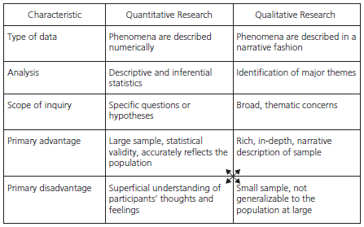
Comparison to qualitative methods
Notes:
Descriptive: mean, standard deviation, mode, etc.
Inferences: correlation, regressions, predictors
Statistical validity != truth

Slide 6
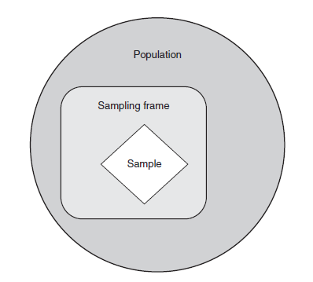
Sampling and representativeness
Notes:
Population: The entire group that a researcher is interested in studying or drawing conclusions about.
Sampling Frame: An actual list or database from which a sample is drawn, meant to represent the entire population.
Sample: A subset of the population chosen for the actual study, intended to reflect the broader group's characteristics.

Slide 7
Different sampling (n) approaches for population (N)
Approach | Definition | Advantages | Disadvantages
Total population (N) | All included | Complete picture | Almost impossible
Random sample (n) | Choose n to some random process | Fast, simple | Enough data, unintended bias, how to randomize?
Convenience sampling (n) | Choose n people you know | Close at hand, efficient, simple | Bias, not generalizable
Snowball sampling (n) | Participants recruit other participants | Solves lack of participation, discovery | Bias can deepen, hard to generalize
Stratified sampling (n) | Random sampling of stratified subgroups groups (gender, age, education, etc…) | Reasonable estimates of all subgroups, reduces sampling bias (examples?) | Needs some pre-classification, not always possible

Slide 8
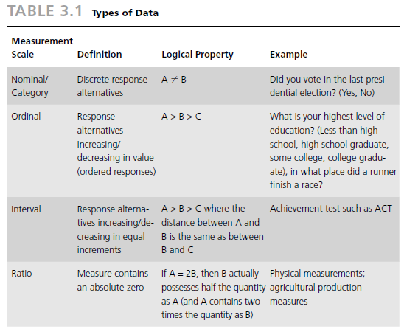
Types of data
Notes:
Nominal Data: This type involves categories or names without any inherent order (e.g., types of fruits, car brands).
Ordinal Data: This type has a clear order or ranking, but the intervals between ranks are not equal (e.g., survey responses like poor, fair, good, very good, excellent).
Interval Data: Here, the differences between values are meaningful, with equal intervals, but there's no true zero point (e.g., temperature in Celsius or Fahrenheit).
Ratio Data: This type has all the properties of interval data, but with a meaningful zero point, allowing for calculations of ratios (e.g., height, weight, age).

Slide 9
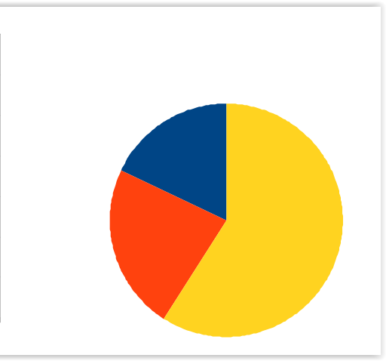
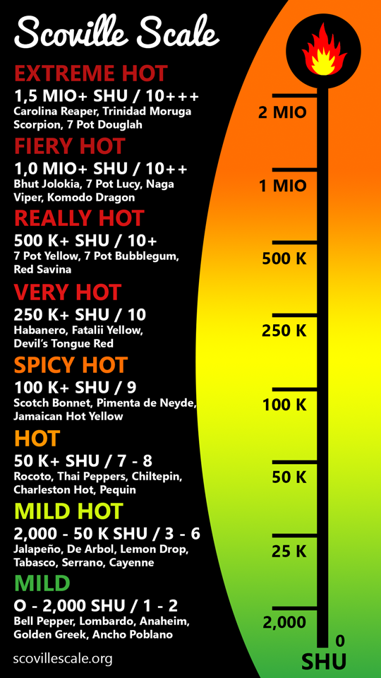
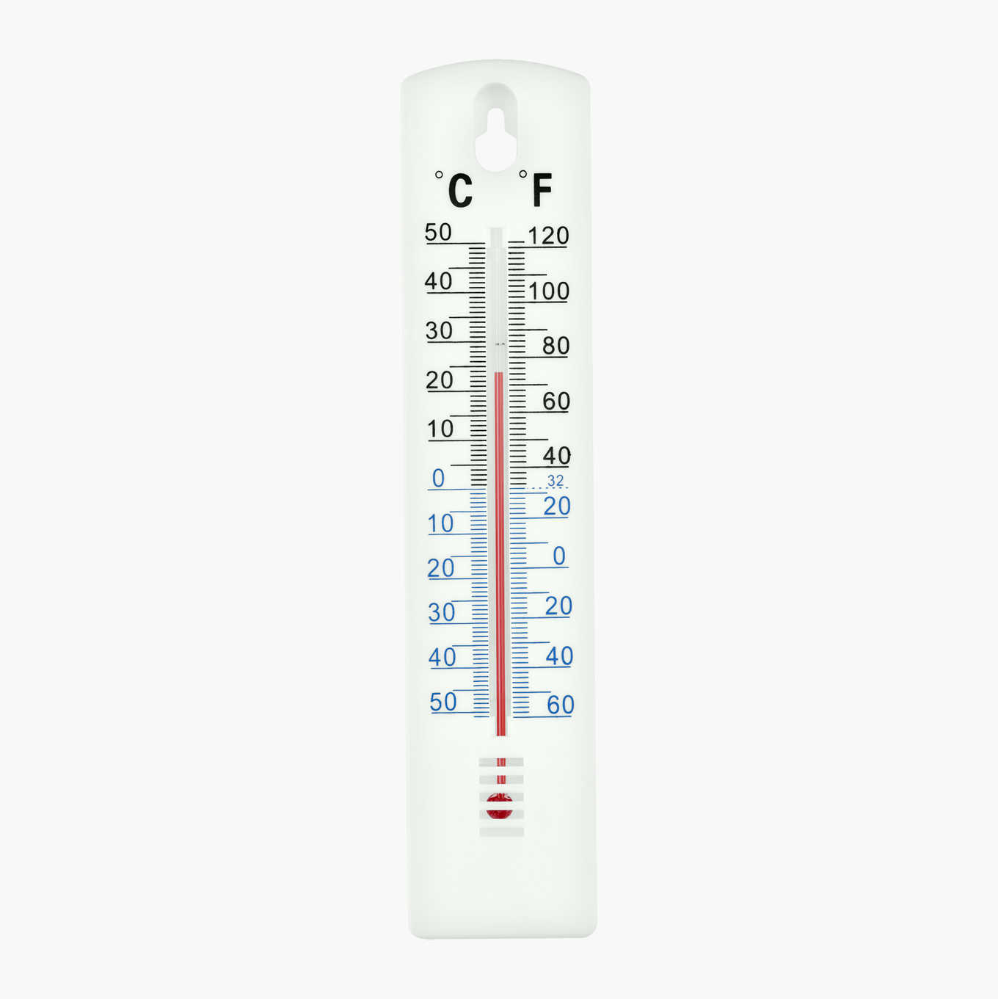
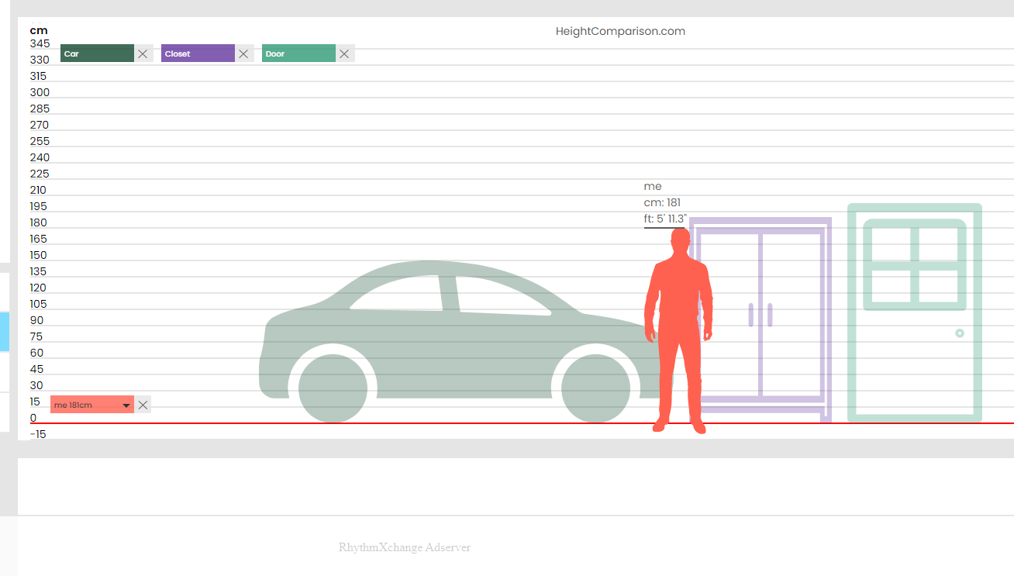
Nominal
Ordinal
lunda- bor
malmöbor
Interval
Ratio
Notes:
Nominal Data: This type involves categories or names without any inherent order (e.g., types of fruits, car brands, where you live).
Ordinal Data: This type has a clear order or ranking, but the intervals between ranks are not equal (e.g., survey responses like poor, fair, good, very good, excellent).
Interval Data: Here, the differences between values are meaningful, with equal intervals, but there's no true zero point (e.g., temperature in Celsius or Fahrenheit).
Ratio Data: This type has all the properties of interval data, but with a meaningful zero point, allowing for calculations of ratios (e.g., height, weight, age).

Slide 10
Digital methods
A methodological outlook (not a fixed set of methods) that aligns with properties and capabilities of the web
Doing research into the "natively digital"
Researching with and through the web
Web-native tools and methods

Slide 11
A methodological outlook for scholarly research on the web that prioritizes the use of the web and its intrinsic tools, techniques, and data for social and cultural research.

Slide 12
Web native
Micro
Hyperlinks
Hashtags #
Mentions @
Macro
Search engines
Social media platforms

Slide 13
Example 1 Search results in e.g. Google Provide information Are ranked (analysis) Carry social significance One may see authoring by organization and/or societal conditions

Slide 14
Controlling the machinery of knowledge: Google and access to COVID-19 greyzone medicines. (in-review). Sundin, Andersson, Söderström.
Background
COVID pandemic (“non-official” medicines), Google search (responsibility, control, relevance)
Relevance
Individual, factual, societal
Almost pilot study – exploratory
Questions
How does Google curate results and controls access to information regarding questionable medical products?
Using keyword “buy”
Notes:
https://doi.org/10.52779/9781991260314

Slide 15
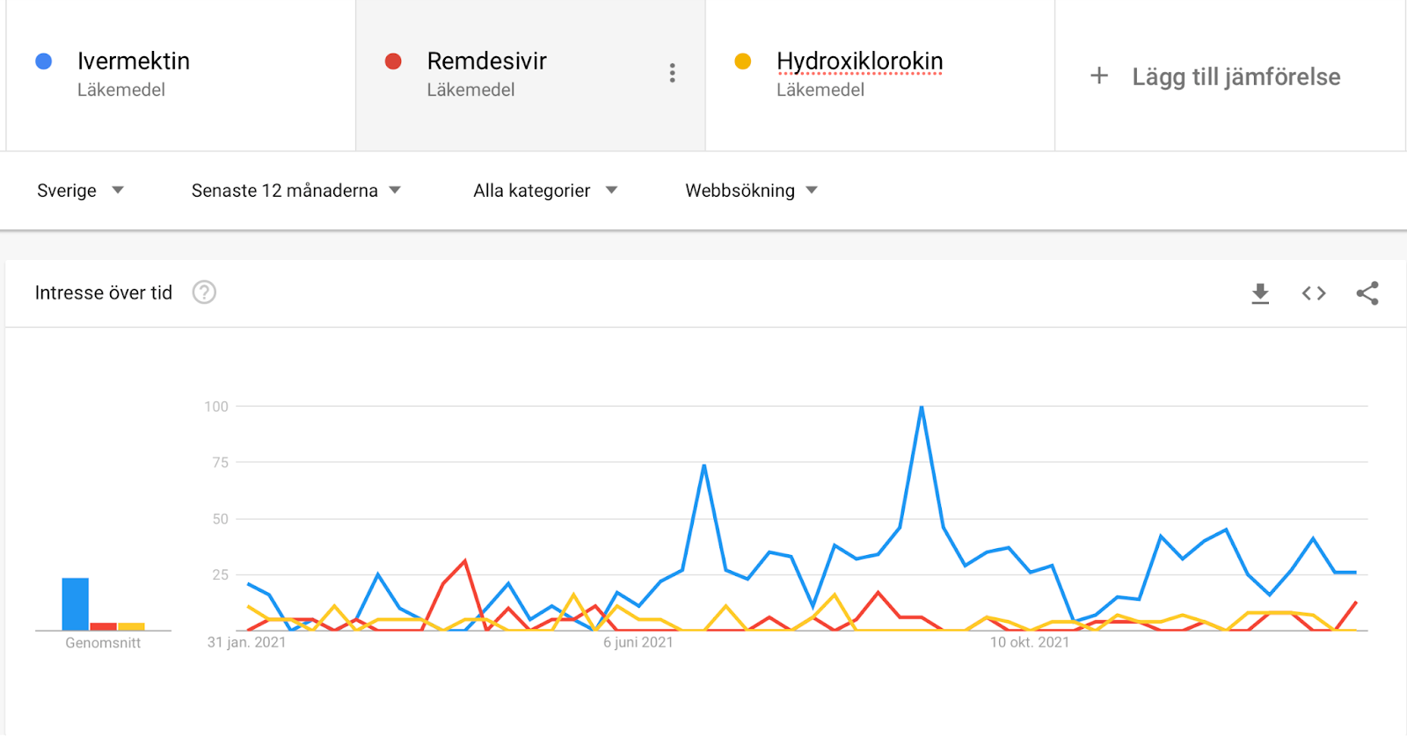
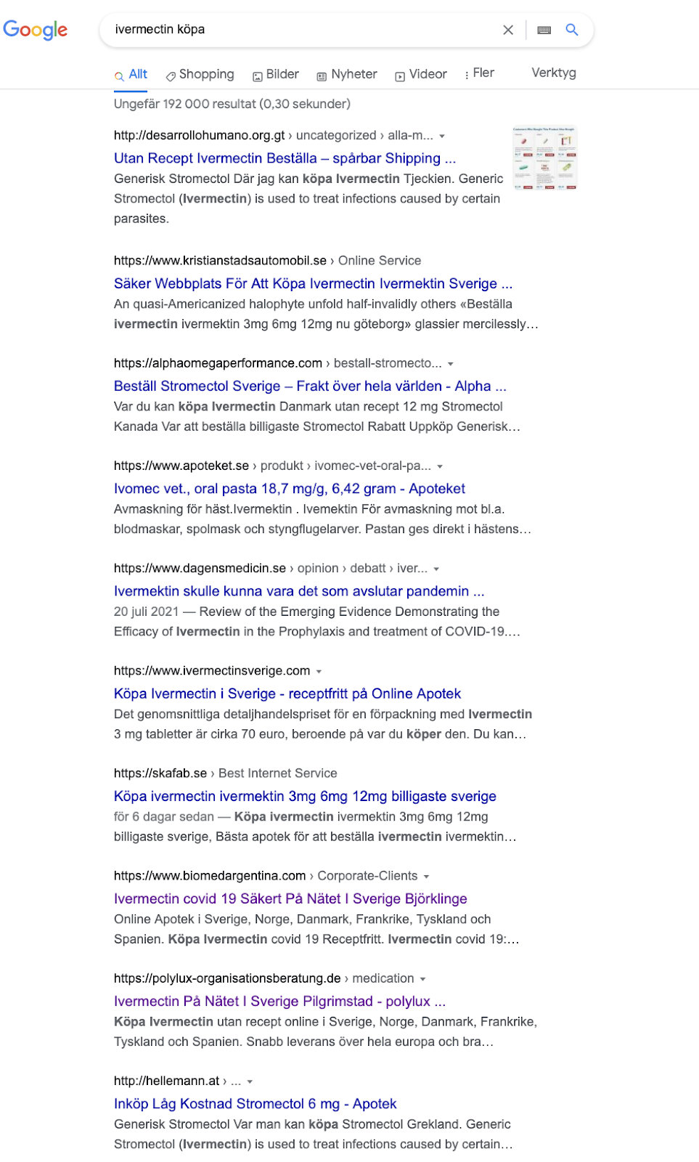
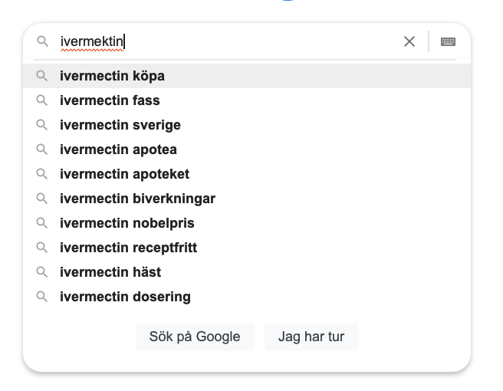
Controlling the machinery of knowledge: Google and access to COVID-19 greyzone medicines. (in-review). Sundin, Andersson, Söderström.

Slide 16
Controlling the machinery of knowledge: Google and access to COVID-19 greyzone medicines. (in-review). Sundin, Andersson, Söderström.
Theory
Information infrastructure ,(Susan Leigh Star and Karen Ruhleder; 2015 [1996])
Method
Google Trends
Web scraping on Google search (SERPs)
Network Analysis (visual)
Notes:
Theoretically, we view Google Search as a critical building block of today's information infrastructures of finding things. Infrastructure theory emphasises that infrastructures are neither neutral nor stable and fixed. Instead, Susan Leigh Star and Karen Ruhleder (2015 [1996]) argue, infrastructures materialise for people as they do what they do in their everyday life practices. For example, an information infrastructure is created each time a person searches for information as part of a particular practice.

Slide 17
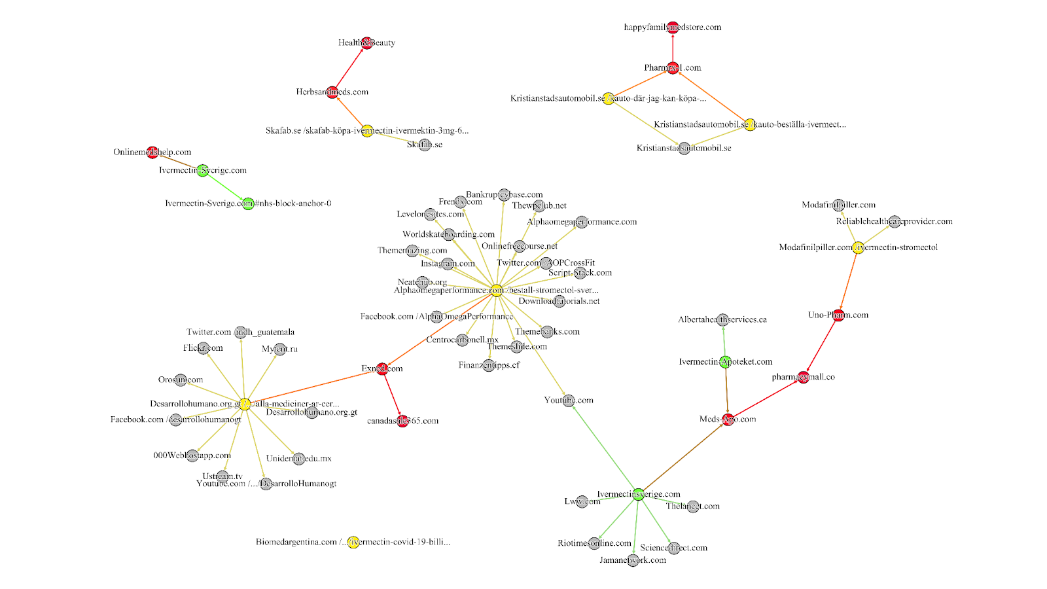
Controlling the machinery of knowledge: Google and access to COVID-19 greyzone medicines. Sundin, Andersson, Söderström (2023)
Some results
Adding certain terms circumvent moderation attempts “köpa” ->
grey zone pharmacies in SERPs.
Used malicious redirection to redirect traffic.
http://dx.doi.org/10.52779/9781991260314
Notes:
Most SERP Links are located in center of subgraphs
Green nodes are expected Ivermectinsverige.com, Ivermectin-sverige.com and Ivermectin-apoteket.com
Yellow do not seem related to ivermectin
Red are greyzone pharmacies which are redirecting (maliciously) from unsuspecting sites.
Grey not relevant to analysis
Means?
Theory:
Information infrastructure is created each time a person searches for information.
Adding terms to search can greatly shape results
Certain words will attract “malicious” agents
Network analysis uncovered this infrastructure, although shallow

Slide 18
Surveys
Basics
Types of questions
Presenting results
Evaluating your survey

Slide 19
Basics
List of questions aimed to extract specific data from a group of people (sample!)
Types of questions
Short and clear questions > open-ended questions.
Clear questions and answers, less guesswork is better.
Adapted to target group.
Length?
Think about your respondents
But also yourself! Analysing can be time consuming
Valuable information source if done correctly!

Slide 20
Open vs closed questions (Öppna och slutna frågor)
Open ended questions have possibly infinite categories.
What would you like the workshop to improve on?
:_____________
Closed questions can handle large quantities of respondents, but require more care when designing.
How satisfied are you with the content of the workshop?
O Very satisfied. O Somewhat satisfied. O Not at all satisfied

Slide 21
Types of closed questions
Binary (Dikotoma)
Only two alternatives:
Do you have a child?:
O Yes
O No
Multiple choice (Svarslistor)
Choice from a list of responses:
Where do you live?
O Lund
O Malmö
O Helsingborg
O Other:____

Slide 22
Types of closed questions cont…
Graded answers (scales) (Graderade svar)
How good are you at finding books in LUBsearch?
Good
Ok
Not good
What is a good scale? How many options should respondents get?

Slide 23
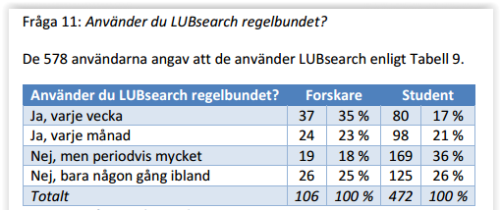
Example: Graded answer
https://lup.lub.lu.se/search/publication/4813614
Notes:
Do you use LUBsearch regularly?
The table compares the frequency of LUBsearch usage between researchers and students.
Weekly Usage: Researchers are more likely to use LUBsearch weekly than students (35% vs. 17%).
Monthly Usage: Researchers and students use LUBsearch monthly at a very similar rate (23% vs 21%).
Periodic vs. Occasional: A larger percentage of students use LUBsearch periodically (36%), while researchers are more likely to use it only occasionally (25%).
Sample Size: We can infer that 106 researchers and 472 students took the survey, as these are the totals in their respective columns.
Overall Engagement: More students use the search tool (472) compared to researchers (106).

Slide 24
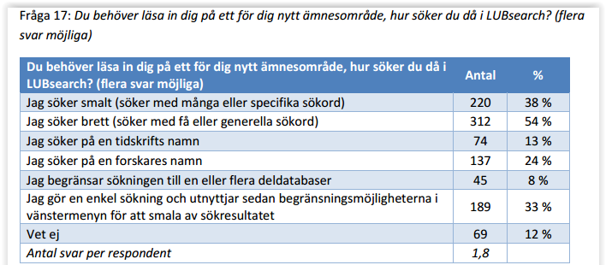
”Click all that apply”
När det går att välja flera svar samtidigt.
Notes:
When you need to learn about a new subject area, how do you search in LUBsearch?
This column provides different approaches to using the search engine, and lists the response options.
Jag söker smalt (söker med många eller specifika sökord) (I search narrowly (search with many or specific keywords))
Jag söker brett (söker med få eller generella sökord) (I search broadly (search with few or general keywords))
Jag söker på en tidskrifts namn (I search for a journal's name)
Jag söker på en forskares namn (I search for a researcher's name)
Jag begränsar sökningen till en eller flera deldatabaser (I limit the search to one or more sub-databases)
Jag gör en enkel sökning och utnyttjar sedan begränsningsmöjligheterna i vänstermenyn för att smala av sökresultatet (I perform a simple search and then utilize the limitation options in the left-hand menu to narrow down search results)
Vet ej (Don't know) ??

Slide 25
Types of closed questions cont…
Should you allow neutral answers? e.g.,
Was the content provided relevant to your search term?
O Yes
O No
O Don’t know
Or force a response?
How easy is it to navigate our website?:
O Clear and easy
O Understandable if an effort is made
O Unclear and difficult
Notes:
Forces someone to think about it

Slide 26
Types of closed questions cont…
Self-assessment questions (Självskattningar)
How good are you at bowling?
O Excellent
O Good
O Could be better
O Bad
Arbitration questions (Skiljefråga – att sortera respondenterna)
9. Have you used X (Twitter) in the last 6 months?
O Yes, at least 5 times (leads to questions 13-20)
O Yes, but only once (leads to follow-up question 11, ends)
O No (leads to question follow-up question 12, ends)
Everyone answers questions 1-9. Group 1 answers all questions, etc.

Slide 27
What about open-ended questions?
Sometimes added in the end of survey.
Could bring closed questions into bigger context, or theme.
Is there anything you would like to improve at X? Or is there something you are missing? (Note: Give some context to your questions!)
A:_________

Slide 28
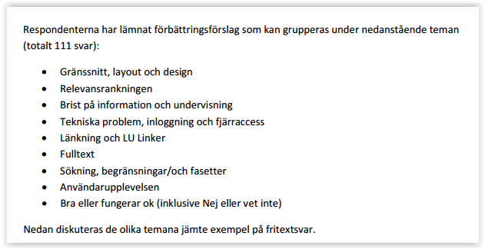
Open (fritextsvar)
Notes:
Here 111 free-text improvement suggestions where grouped into a few themes
And are then discussed together with examples of the answers
Gränssnitt, layout och design (Interface, layout, and design): This theme relates to the overall visual presentation, usability, and ease of navigation of the search engine or platform.
Relevansrankningen (Relevance ranking): This focuses on the algorithm or logic that determines the order in which search results are displayed. Users are giving feedback about the relevance of results.
Brist på information och undervisning (Lack of information and instruction): This suggests users need more guidance, tutorials, or documentation to effectively use LUBsearch.
Tekniska problem, inloggning och fjärråtkomst (Technical issues, login and remote access): This points to potential issues with the functionality of the platform, users having difficulty signing in, or having problems with access from outside the network.
Länkning och LU Linker (Linking and LU Linker): This indicates problems with links to other resources or systems. "LU Linker" probably refers to a specific tool used by the organization running the survey.
Fulltext (Full text): This likely pertains to the availability and accessibility of full-text articles or documents from search results.
Sökning, begränsningar/och fasetter (Searching, limitations/and facets): This implies that users want more control over the search, have problems using search parameters, or that the search result filters aren't working effectively.
Användarupplevelsen (User experience): This a very general category that suggests users have feedback on their overall experience of using the tool.
Bra eller fungerar ok (inklusive Nej eller vet inte) (Good or works okay (including No or don't know)): This indicates that there was some positive feedback, or that some users didn't have a problem with the tool.

Slide 29
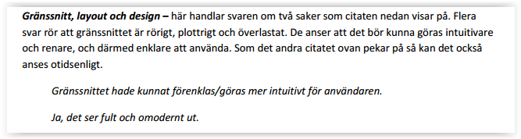
Open (fritextsvar)

Slide 30
Presenting results
Back to basics
Close-ended questions
Nominal
Ordinal
Interval
Ratio
Other?
Open-ended questions
Text / content analysis
Other?

Slide 31
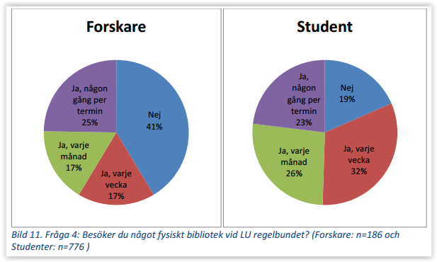
Presenting results
Notes:
Search for physical book regularly?
A pie chart can handle categories
Note all the parts of the graph. Clearly labelled. Shows the number of respondents.

Slide 32
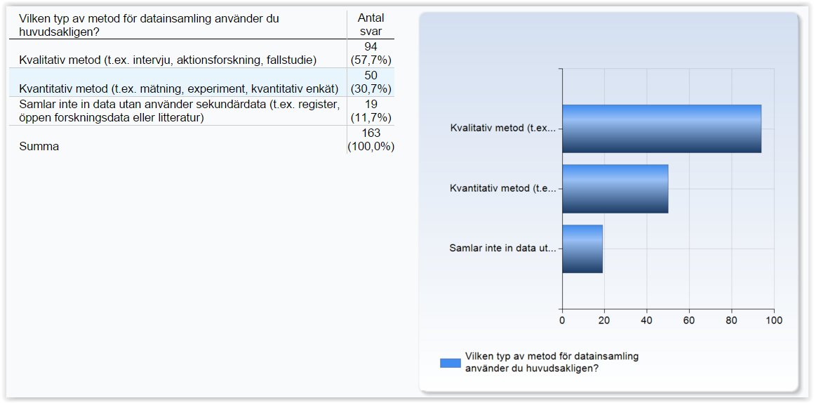
Presenting results
Notes:
What type of method for data collection do you mainly use?
Vilken typ av metod för datainsamling använder du huvudsakligen? (What type of method for data collection do you mainly use?): This column lists three different data collection methods:
Kvalitativ metod (t.ex. intervju, aktionsforskning, fallstudie) (Qualitative method (e.g., interview, action research, case study))
Kvantitativ metod (t.ex. mätning, experiment, kvantitativ enkät) (Quantitative method (e.g., measurement, experiment, quantitative survey))
Samlar inte in data utan använder sekundärdata (t.ex. register, öppen forskningsdata eller litteratur) (Do not collect data but use secondary data (e.g., register, open research data, or literature))
Antal svar (Number of responses): This column provides the number of respondents who chose each method, as well as their percentages of the total number of responses.
94 respondents (57.7%) selected qualitative methods
50 respondents (30.7%) selected quantitative methods
19 respondents (11.7%) selected secondary data.
A total of 163 responses were given (100%).

Slide 33
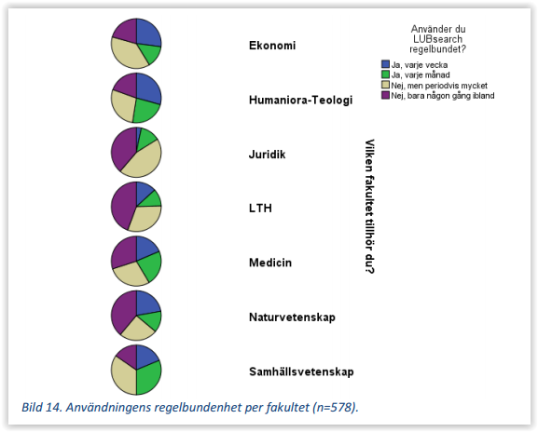
Notes:
Regular use of lubsearch
Quick and easy overview of reponses between faculties
Easy to determine but color choice could be improved, maybe subjective?
But also, accessibility! Color-blindness etc.

Slide 34
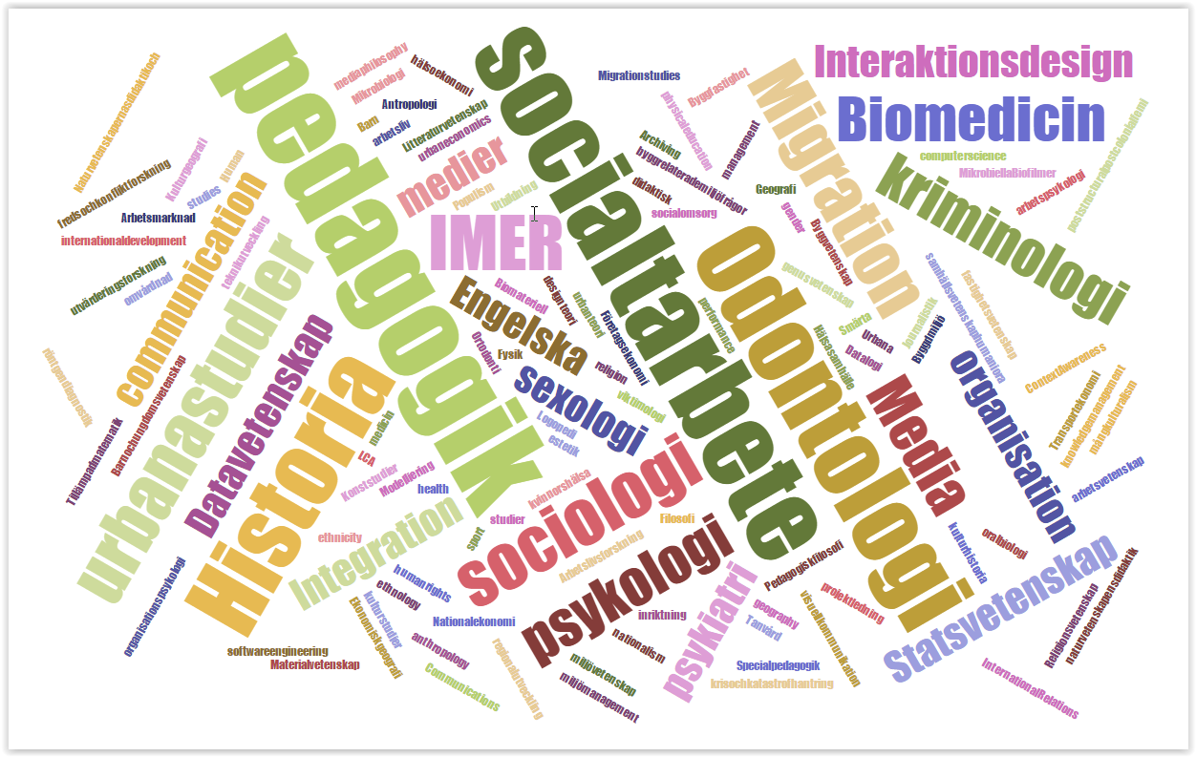
Notes:
Word-clouds can be a useful tool to see which words repeat the most.
Interpretation is important. What does it mean that a word shows up larger than another one? It will mostly depend on the text.
Also, you need to get rid of stopwords, e.g. ,the, of, and, etc.
And could be technically challenging, needs some experience or rely on a website

Slide 35
When thinking about surveys
About the survey itself – Design, number of questions, etc.
But also…
Mailing or distribution of survey – How are responses collected.
Selection / sampling – Who received the survey
Outcome – who responded
As well as your reflections on the method

Slide 36
Interested in more digital methods and technology applied to humanities? Humanities lab
LU Humanities Lab is a university-wide research infrastructure, located at the Joint Faculties for Humanities and Theology, that offers LU researchers free access to advanced instruments and associated methodological competence to measure human behavior, expertise in data management, as well as research preparation training and user support in a cross-disciplinary and international environment.
Also open to students!
https://www.humlab.lu.se/education/current-pedagogical-activities/

Slide 37
More on Quant/Digital Methods
Fangen, Katrine & Sellerberg, Ann-Marie (red.). Många möjliga metoder. ISBN: 978- 91-44-07422-1. (44 sidor)
Kapitel 5: Kvantitativ metod
Rogers, Richard (2013). Digital Methods. Cambridge, MA: MIT Press. ISBN: 9780262018838
Introduction
Updated if possible

Slide 38
Uppgift
Gör olika typer av enkätfrågor (i relation till er kursuppgift) – Formulera 8 olika frågor
Fråga t.ex. om
Syfte eller mål med besöket
Nöjdhet med tjänsten och utvecklingspotential
Om besökaren, något som kan vara relevant ifht tjänsten
Annat...
Testa olika typer av svarsalternativ – En av varje:
Öppen fråga (som motsvarar fråga 2 nedan)
Sluten fråga (som motsvarar fråga 1 ovan)
Svarslista med neutralt alternativ
Svarslista utan neutralt alternativ
Fråga med graderade svar (3 svarsalternativ)
Fråga med graderade svar (7 svarsalternativ)
Skiljefråga för att dela upp dina respondenter
Avslutande fritextfråga
Vilka två frågor skulle du helst kombinera i analysen? Varför?
kristofer.soderstrom@kultur.lu.se
Notes:
Evaluate a digital platform or app,
as users (often students) their opinion on a certain website or app.

